Slide 1
Special GRAPHS (Perfect & PLANAR)

Slide 2
Graphs With Special Topology
Until now we have been looking at graphs, but did not focus so much on their topology
If graphs have special structures then we can develop improved algorithms
We can also identify patterns occurring in real world applications

Slide 3
Perfect Graphs
A perfect graph is a graph in which the chromatic number equals the size of the maximum clique, both in the graph itself and in every induced subgraph.
Graph coloring, Maximal Clique, Independent Set problem, can all be solved in polynomial time on perfect graphs.
Many types of perfect graphs
Chordal Graphs (my favorite)
Interval Graphs
Comparability Graphs
Bipartite Graphs
Perfect graph theorem: The complement of a perfect graph is perfect
Strongly perfect graph theorem: Neither a perfect graph nor its complement contains an odd length induced cycle of size 5 or more

Slide 4
Chordal Graphs
B
C
F
Chordal graphs are graphs where the largest unbroken cycle is a triangle
A perfect elimination ordering in a graph is an ordering of vertices v, such that the neighbors of v that occur after v form a clique.
All chordal graphs have at least one simplicial vertex, whose neighbors form a clique
If the simplicial vertex is removed then the resultant graph remains chordal
Thus chordal graphs have perfect elimination ordering
D
E
Percentage of Chordality in real world graphs

Slide 5
Maximal Chordal Graphs
Algorithm to extract the maximal chordal graph from a general graph
(Dearing et. al. 1988)

Slide 6
Chordal Graphs
Finding chromatic number in chordal graphs is polynomial time
Find the perfect ordering and then color in reverse (Maffray 2003)
Finding the maximum clique is polynomial time
Find the cliques at each vertex of the perfect elimination ordering and then see which is maximal

Slide 7
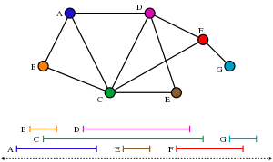
INTERVAL GRAPHS
Interval graphs are model a set of intervals on a real line, where each interval is a vertex and two vertices are connected if the intervals overlap
Interval graphs are a subset of chordal graphs
Used in scheduling problems, DNA assembly sequences etc.

Slide 8
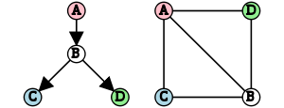
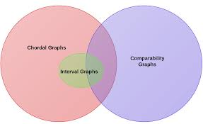
Comparability Graphs
A comparability graph is an undirected graph whose vertices can be ordered in a partial order.
The vertices can be oriented while maintaining these properties
Anti symmetry if v->u then -> does not exists
Transitivity if a→b and b→c exists then a→ c must exist
Complement of interval graphs is a comparability graph
Comparability graphs are perfectly orderable. Can find optimal coloring by following the transitive ordering
Relation between chordal and comparability graphs

Slide 9
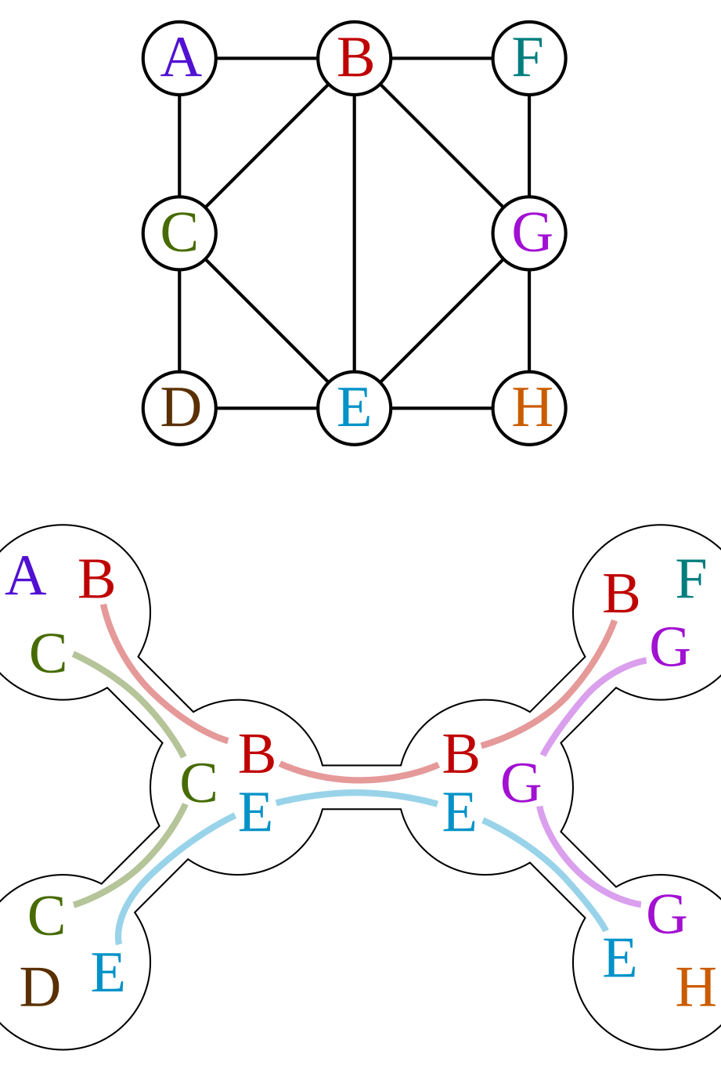
TREE DECOMPOSITION
A tree decomposition is a mapping of a graph into a tree that can be used to define the treewidth of the graph
Given a graph G = (V, E), a tree decomposition is a pair (X, T), where X = {X₁, …, X_{n}} is a family of subsets (sometimes called bags) of V, and T is a tree whose nodes are the subsets X_{i}, with the following properties
The union of all sets X_{i} equals V. That is, each graph vertex is associated with at least one tree node.
For every edge (v, w) in the graph, there is a subset X_{i} that contains both v and w.
f X_{i} and X_{j} both contain a vertex v, then all nodes X_{k} of the tree in the (unique) path between X_{i} and X_{j} contain v as well.
Tree width is the largest Xi size -1. Goal is to minimize tree width

Slide 10
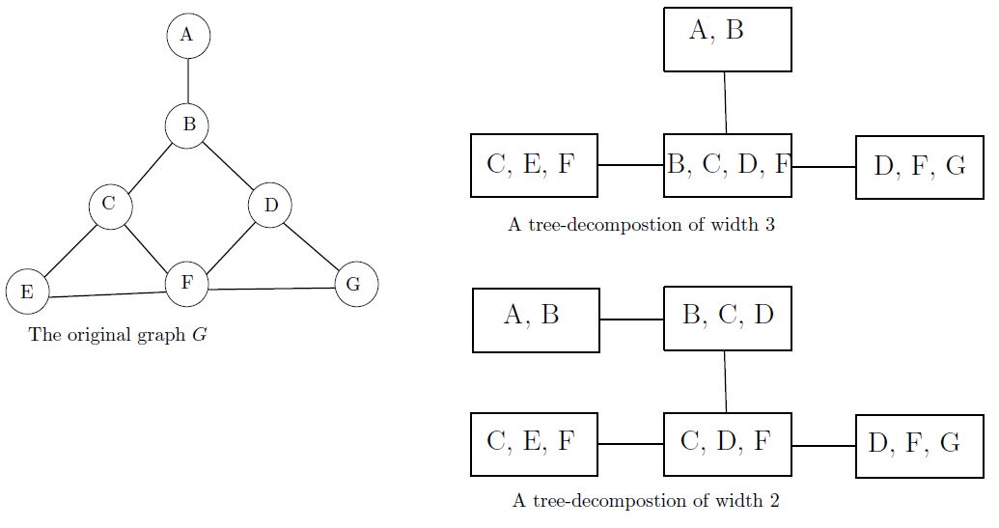
TREE DECOMPOSItion
Find Simplicial vertex
All vertices in the clique will be in Xi
If not Simplicial vertex found, find cycles to form Xi
Connect Xis that have common neighbors
Break cycles if neeeded

Slide 11
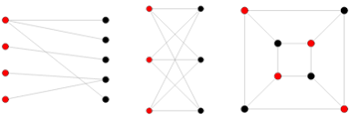
Bipartite Graphs
Bipartite graphs are graphs where vertices can be partitioned into two sets A and B, such that there are no edges within the vertices of a set
Used in matching problems
Matching sets of students to advisors
Matching applicants to jobs
Dating profiles
Bipartite graphs cannot have odd cycles
Easy to check if graph is bipartite using BFS or DFS to search for odd cycles

Slide 12
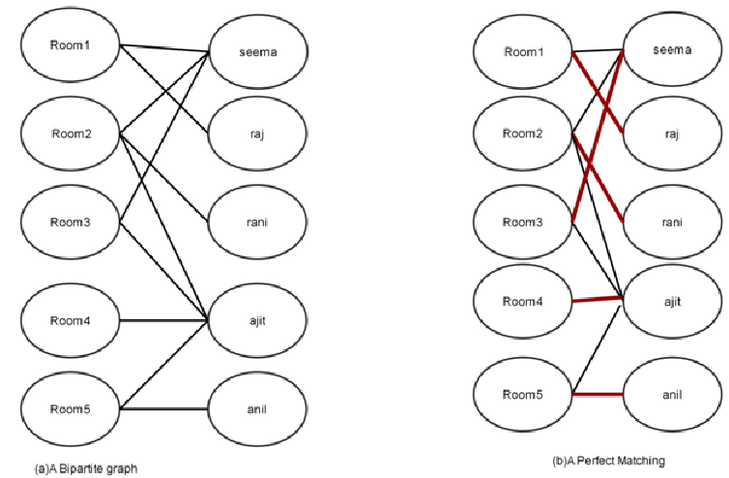
PERFECT Matching
A perfect matching of a graph is a matching (i.e., an independent edge set) in which every vertex of the graph is incident to exactly one edge of the matching.
Example: matching from a set V1 of students to a set V2 of rooms occurs if every applicant is matched to one job

Slide 13
HALL’s MARRIAGE Theorem
Given a set of job applicants in set A (|A|=m) and a set of jobs in set B (|B|>=m), how many jobs should each applicant apply to such that every one gets a job. Assume that they are qualified for all the jobs
Hall’s Marriage Theorem (1935): Given there are m applicants in set A, a necessary and sufficient condition for each applicant to find a job is that every set of k applicants applies to at least k jobs; 1<=k<=m.
Case 1: Every set of k applicants applies for k+1 jobs.
Match 1 job with one applicant, and the problem reduces to set m-1.
Case 2: Every set of k applicants applies for exactly k jobs.
K applicants can be matched K jobs, leaving m-K applicants. Any collection h among these remaining applicants must have applied to at least h jobs to satisfy the condition. So the problem reduce to set m-k.

Slide 14
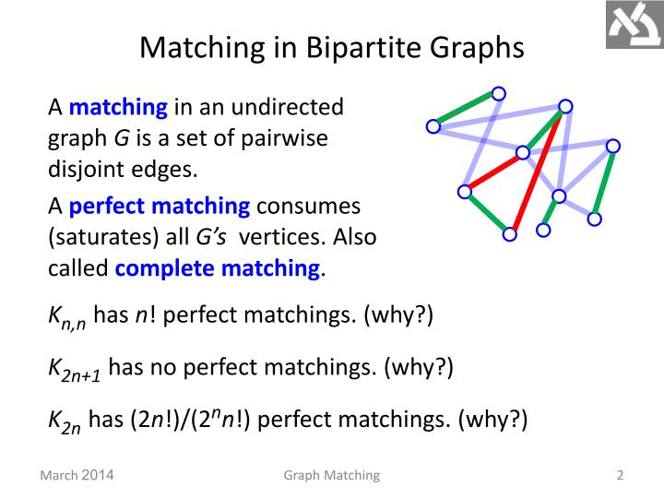
https://www.slideserve.com/urbana/graph-matching

Slide 15
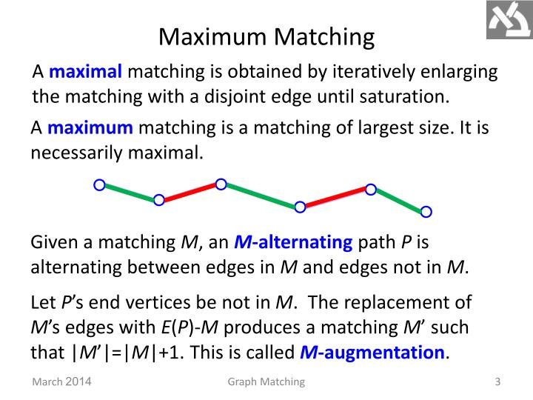

Slide 16
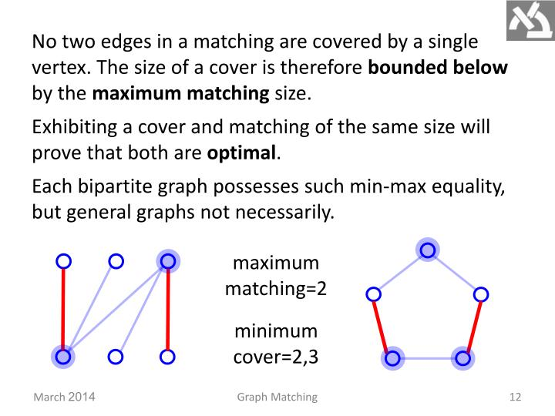
If a graph is bipartite then size of its maximum matching is equal to minimum vertex cover.

Slide 17
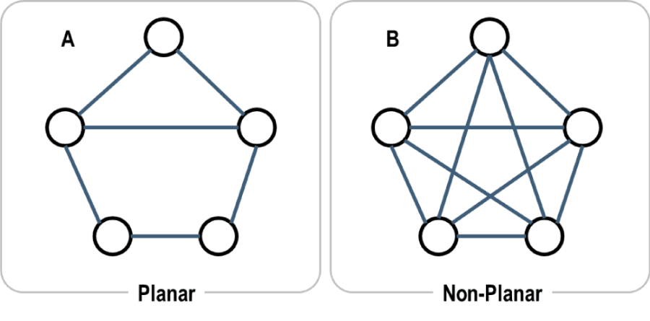
Planar Graphs
Planar graphs are graphs that can be embedded in a plane. That is they can be drawn without the lines crossing each other.
The two smallest non-planar graphs are
K5: Complete graphs of five vertices
K3,3: Complete bipartite graph of 3 vertices in each set
Kuratowski’s theorem (1930): A graph is planar if and only if it contains no subgraph homeomorphic to K5 or K3,3
Two graphs are homeomorphic if
Removing edges and vertices. (Making a subgraph.)
Collapsing degree-two vertices into a single edge.
Applying an isomorphism to turn it into K3,3 or K5.

Slide 18
EULER’s Formula
If G is a planar graph, then any plane drawing of G divides the set of points of the plane not lying on G into regions, called faces.
For a simple planar graph with n vertices, m edges and f faces: n-m+f=2

Slide 19
Theorems related to EULER’S FORMULA
Let G be a planar graph with n vertices, m edges, f faces and k components. Then; n-m+f= k+1
If G is a connected simple planar graph with n>4 vertices and m edges, then m<=3n-6
In addition, if G has no triangles then m<=2n-4
Every planar graph has at least one vertex of degree less than equal to 5

